Slide 1

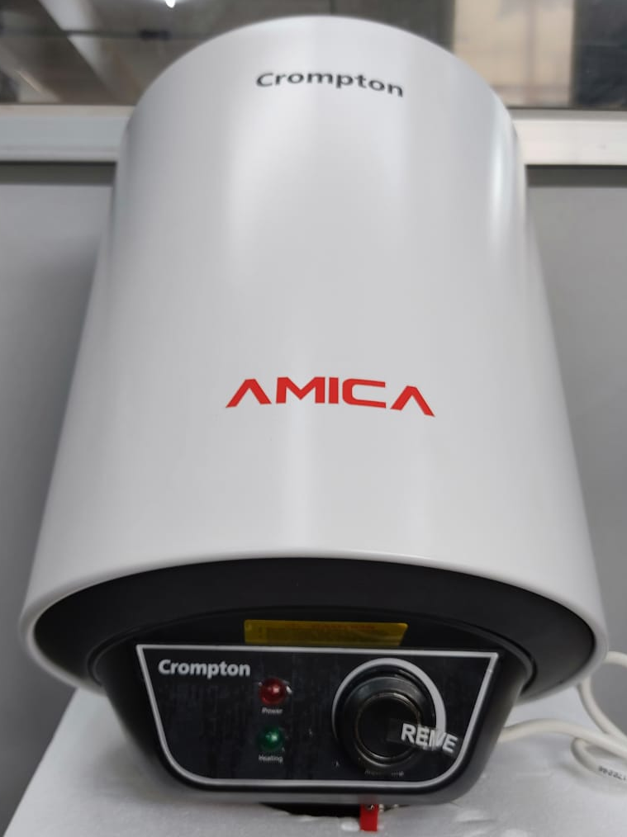
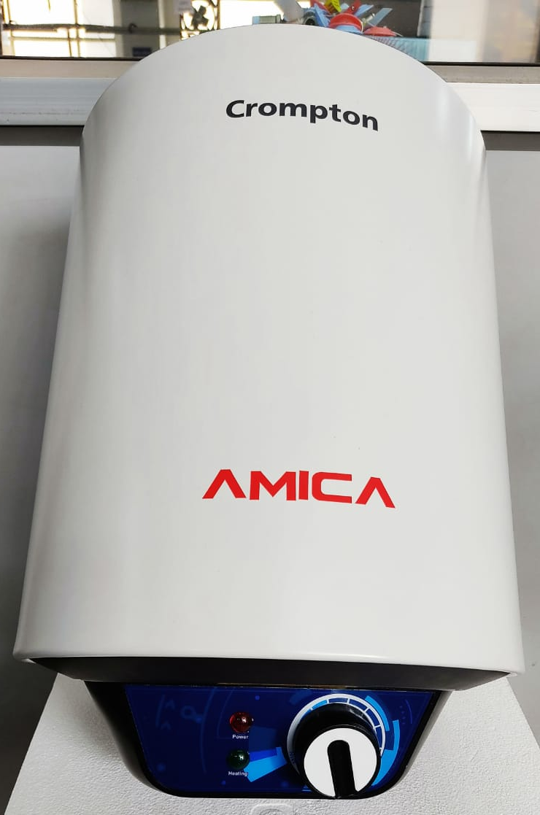
New Designed Amica Knob & PC Sticker Comparison
10 ltr Amica
BEFORE
AFTER
New Knob & New PC sticker

Slide 2
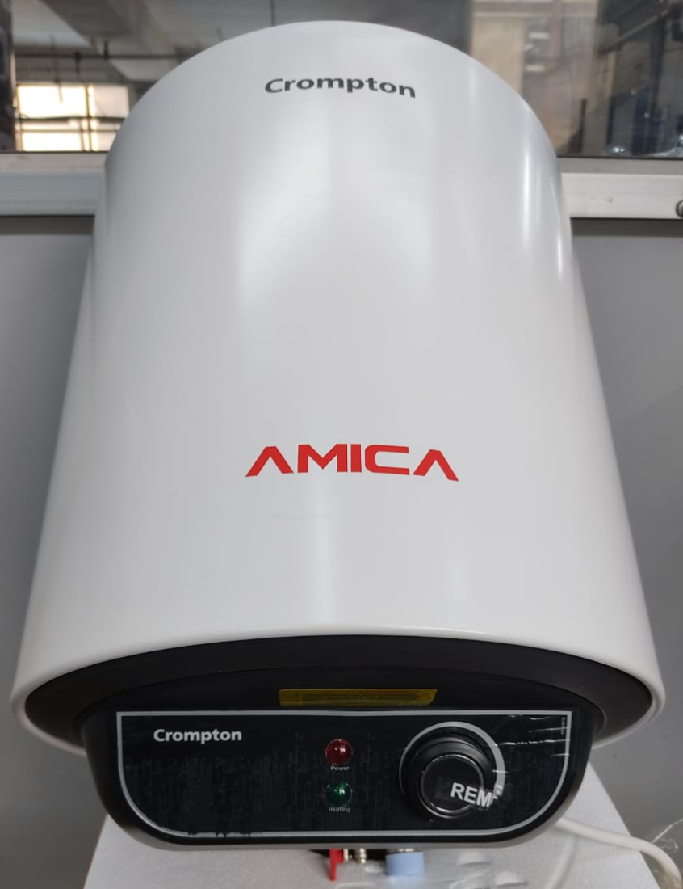
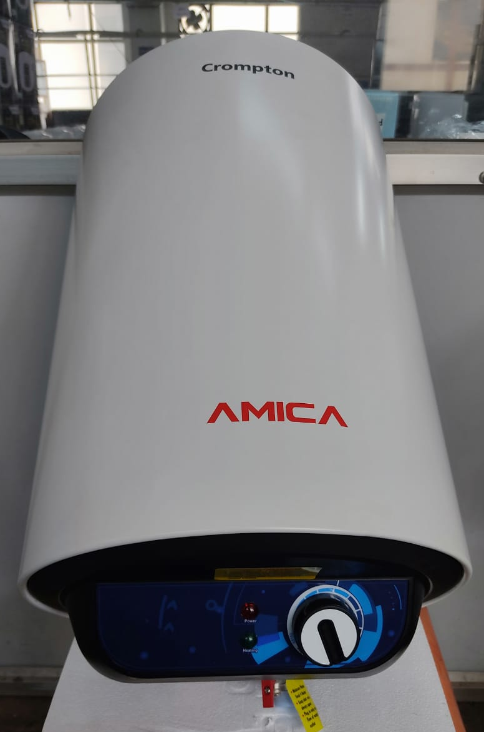
New Designed Amica Knob & PC Sticker Comparison
15 ltr Amica
BEFORE
AFTER
New Knob & New PC sticker

Slide 3
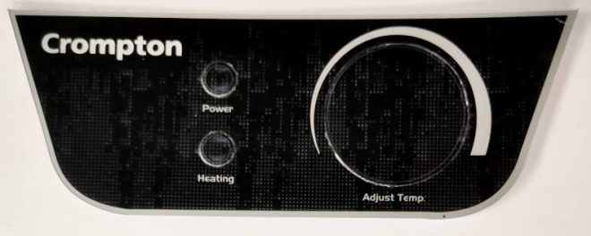
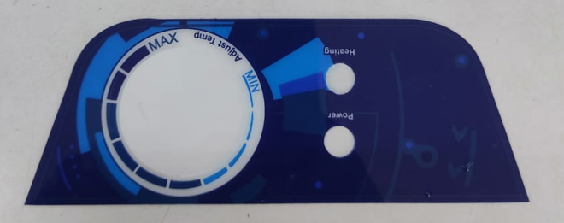
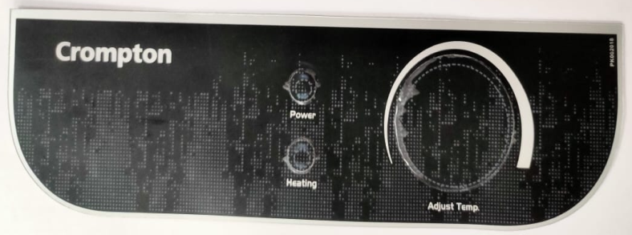
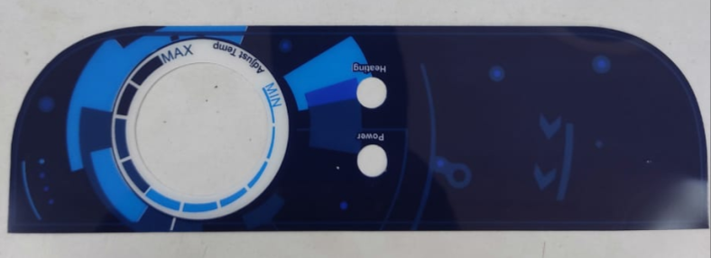
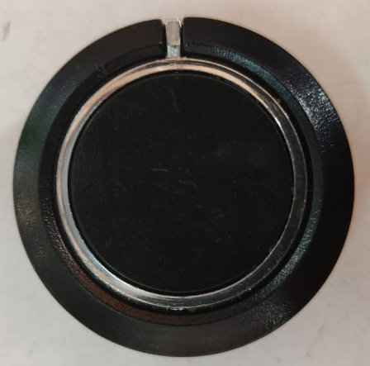
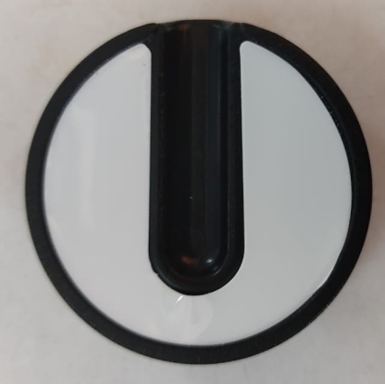
New Designed Amica Knob & PC Sticker Comparison
BEFORE
AFTER
10 Ltr
10 Ltr
15 & 25 Ltr
15 & 25 Ltr
Knob
Knob

Slide 4
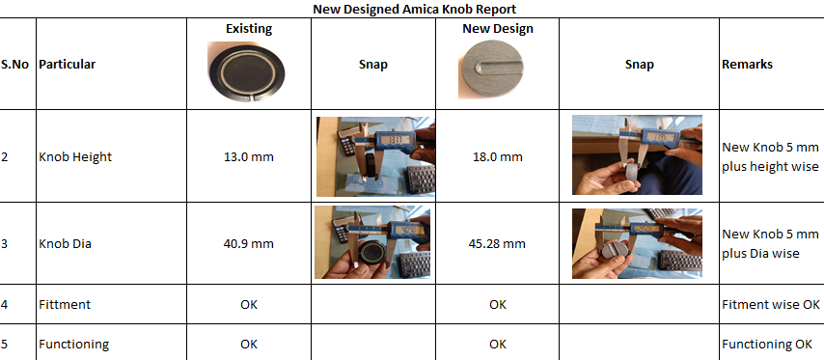
New Designed Amica Knob Comparison

